Slide 1
Clustering -Part II
Data Analytics - WQD 7003

Slide 2
What is clustering?
Clustering: the process of grouping a set of objects into classes of similar objects
Most common form of unsupervised learning
Unsupervised learning = learning from raw data, as opposed to supervised data where a classification of examples is given
Ref: [5]

Slide 3
Clustering
Ref: [5]
Notes:
Here I’m showing some data to cluster
Let’s say high-D data, but projected it down to 2 most important dimensions for clustering
It’s obvious to us even with 2-D projection that red points shouldn’t be in same cluster
But, standard clustering algorithm like GAC needs to compare these using all dimensions of the data
However, different story for the blue points.
Here, using the projection, we don’t know if they are in the same cluster.
We’d want to use the high-D metric to determine if there should be clustered together or apart.
We can encode exactly this type of information in an overlapping clustering of the data created by the inexpensive distance metric

Slide 4
Clustering
Ref: [5]
Notes:
Here I’m showing some data to cluster
Let’s say high-D data, but projected it down to 2 most important dimensions for clustering
It’s obvious to us even with 2-D projection that red points shouldn’t be in same cluster
But, standard clustering algorithm like GAC needs to compare these using all dimensions of the data
However, different story for the blue points.
Here, using the projection, we don’t know if they are in the same cluster.
We’d want to use the high-D metric to determine if there should be clustered together or apart.
We can encode exactly this type of information in an overlapping clustering of the data created by the inexpensive distance metric

Slide 5
Clustering – Reference matching
Fahlman, Scott & Lebiere, Christian (1989). The cascade-correlation learning architecture. In Touretzky, D., editor, Advances in Neural Information Processing Systems (volume 2), (pp. 524-532), San Mateo, CA. Morgan Kaufmann.
Fahlman, S.E. and Lebiere, C., “The Cascade Correlation Learning Architecture,” NIPS, Vol. 2, pp. 524-532, Morgan Kaufmann, 1990.
Fahlman, S. E. (1991) The recurrent cascade-correlation learning architecture. In Lippman, R.P. Moody, J.E., and Touretzky, D.S., editors, NIPS 3, 190-205.
Ref: [5]
Notes:
Task: clustering bibliographic citations
Here are 3 citations from bibliography sections of 3 different papers. First two clustered together. Third refers to different paper and forms separate cluster
Note that variations in formatting, field ordering, abbreviation and even misspellings and misinformation make this a challenging clustering problem.
Why collected this data?

Slide 6
Clustering – Reference matching
Fahlman, Scott & Lebiere, Christian (1989). The cascade-correlation learning architecture. In Touretzky, D., editor, Advances in Neural Information Processing Systems (volume 2), (pp. 524-532), San Mateo, CA. Morgan Kaufmann.
Fahlman, S.E. and Lebiere, C., “The Cascade Correlation Learning Architecture,” NIPS, Vol. 2, pp. 524-532, Morgan Kaufmann, 1990.
Fahlman, S. E. (1991) The recurrent cascade-correlation learning architecture. In Lippman, R.P. Moody, J.E., and Touretzky, D.S., editors, NIPS 3, 190-205.
Ref: [5]
Notes:
Task: clustering bibliographic citations
Here are 3 citations from bibliography sections of 3 different papers. First two clustered together. Third refers to different paper and forms separate cluster
Note that variations in formatting, field ordering, abbreviation and even misspellings and misinformation make this a challenging clustering problem.
Why collected this data?

Slide 7
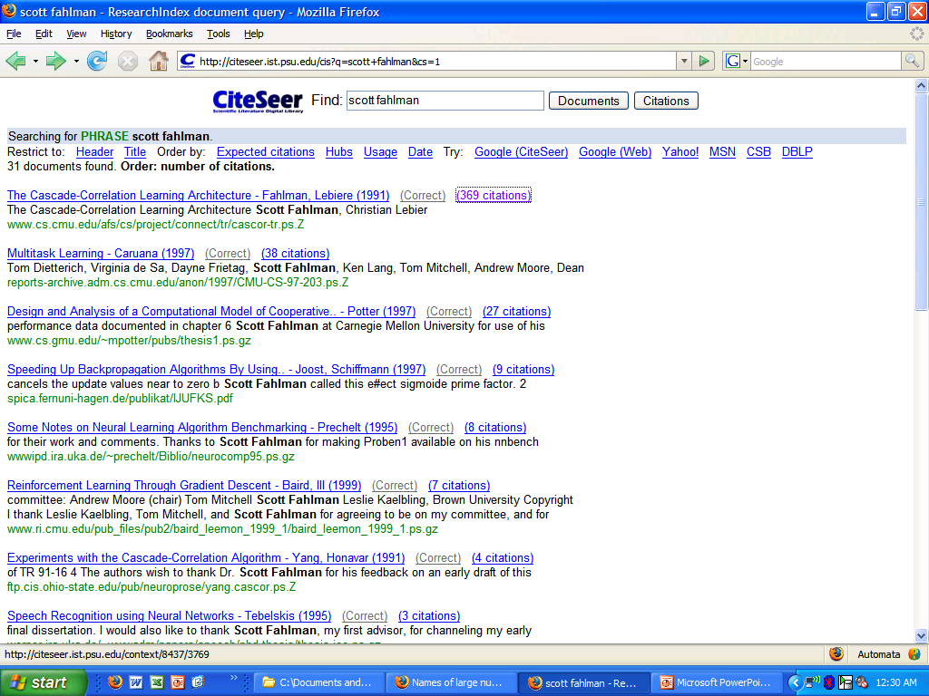
Citation ranking
Ref: [5]

Slide 8
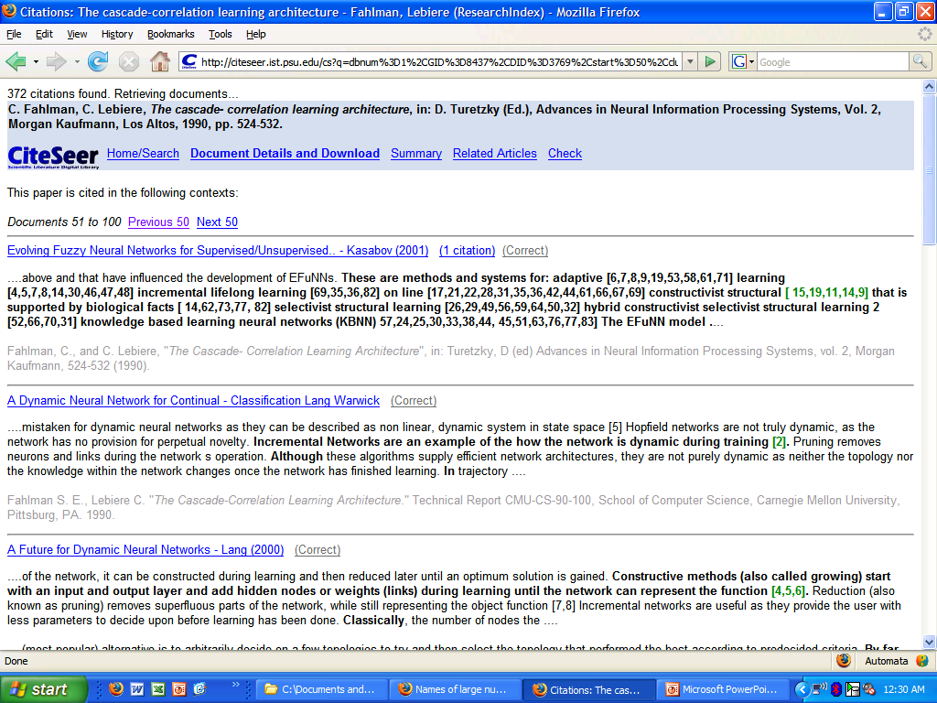
Citation graph browsing
Ref: [5]

Slide 9
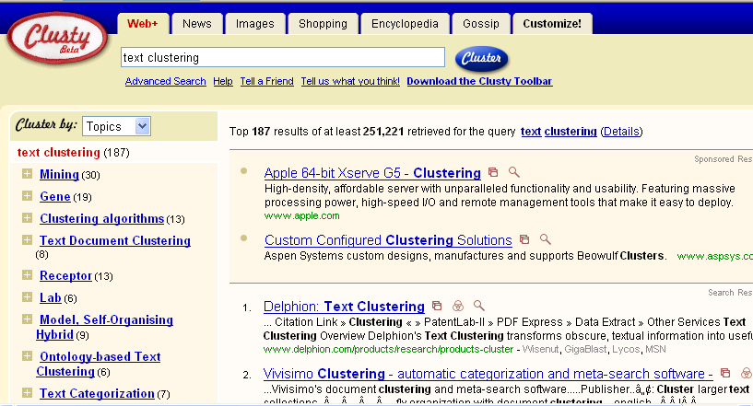
Clustering: Navigation of search results
For grouping search results thematically
clusty.com / Vivisimo
Ref: [5]

Slide 10
Clustering: Corpus browsing
www.yahoo.com/Science
… (30)
agriculture
biology
physics
CS
space
...
...
...
...
...
dairy
crops
botany
cell
AI
courses
craft
magnetism
HCI
missions
forestry
agronomy
evolution
relativity
Ref: [5]
Notes:
Final data set:
Yahoo Science hierarchy, consisting of text of web pages pointed to by Yahoo, gathered summer of 1997.
264 classes, only sample shown here.

Slide 11
Clustering considerations
What does it mean for objects to be similar?
What algorithm and approach do we take?
Top-down: k-means
Bottom-up: hierarchical agglomerative clustering
Do we need a hierarchical arrangement of clusters?
How many clusters?
Can we label or name the clusters?
How do we make it efficient and scalable?

Slide 12
Hierarchical Clustering
Use distance matrix as clustering criteria. This method does not require the number of clusters k as an input, but needs a termination condition
Step 0
Step 1
Step 2
Step 3
Step 4
agglomerative
(AGNES)
a
a b
b
a b c d e
c
c d e
d
d e
e
divisive
(DIANA)
Step 4
Step 3
Step 2
Step 1
Step 0

Slide 13
Hierarchical Clustering
Two main types of hierarchical clustering
Agglomerative:
Start with the points as individual clusters
At each step, merge the closest pair of clusters until only one cluster (or k clusters) left
Divisive:
Start with one, all-inclusive cluster
At each step, split a cluster until each cluster contains a point (or there are k clusters)
Property of Hierarchical clustering
It keeps a “history” on how we group the points
It stretches to both extreme. One is one-point cluster, while the other is all-in-one cluster

Slide 14
Dendrogram: Shows How Clusters are Merged
Decompose data objects into a several levels of nested partitioning (tree of clusters), called a dendrogram
A clustering of the data objects is obtained by cutting the dendrogram at the desired level, then each connected component forms a cluster
A dendrogram (from Greek dendro "tree" and gramma "drawing") is a tree diagram frequently used to illustrate the arrangement of the clusters produced by hierarchical clustering.

Slide 15
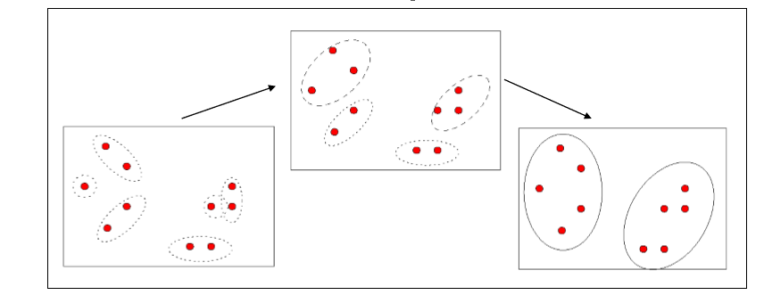
AGNES (Agglomerative Nesting)
Step1: every object is placed into a cluster of its own
Step2: merge the clusters according to the minimum Euclidean distance between the nearest objects in the clusters
Step3: if arriving a “whole” cluster, exit; otherwise go to Step 2

Slide 16
How do we choose which clusters to merge ?
Various methods
Single link distance
Complete link distance
Average distance

Slide 17
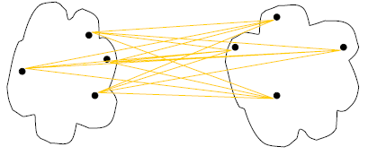
Cluster Distance Measures
Single link: smallest distance between an element in one cluster and an element in the other, i.e., d(C_{i}, C_{j}) = min{d(x_{ip}, x_{jq})}
Complete link: largest distance between an element in one cluster and an element in the other, i.e., d(C_{i}, C_{j}) = max{d(x_{ip}, x_{jq})}
Average: avg distance between elements in one cluster and elements in the other, i.e.,
d(C_{i}, C_{j}) = avg{d(x_{ip}, x_{jq})}
single link
(min)
complete link
(max)
average
Ref: [6]
Notes:
Define D(C, C)=0, the distance between two exactly same clusters is ZERO!

Slide 18
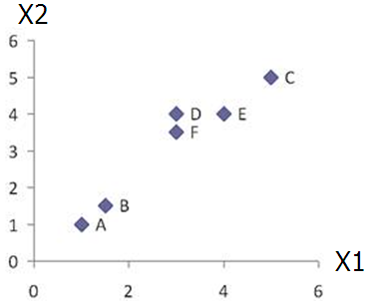
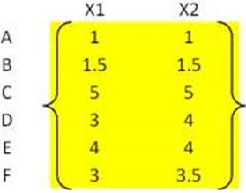
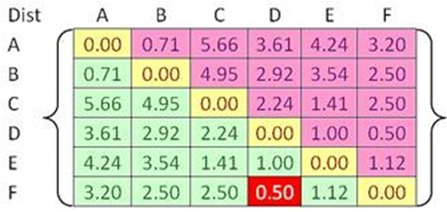


Example
Problem: clustering analysis with agglomerative algorithm
data matrix
Euclidean distance
distance matrix
Ref: [6]

Slide 19
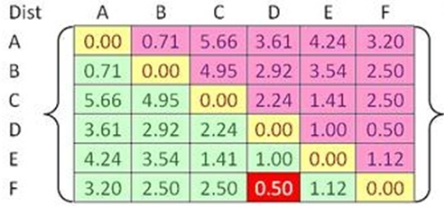
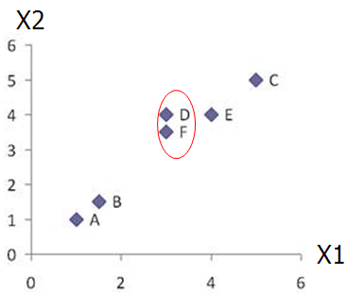
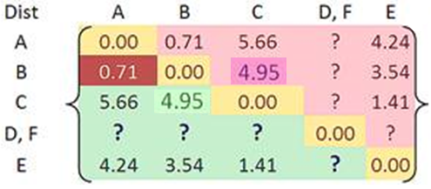

Example
Merge two closest clusters (iteration 1)
Ref: [6]

Slide 20
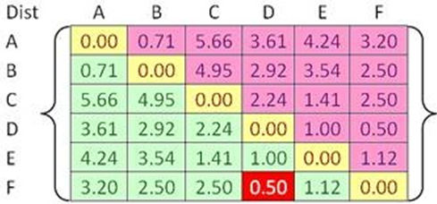

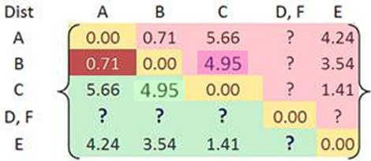
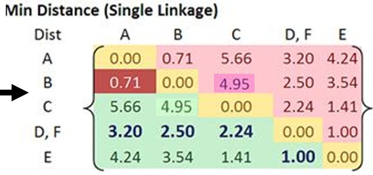
Example
Update distance matrix (iteration 1)
Ref: [6]

Slide 21
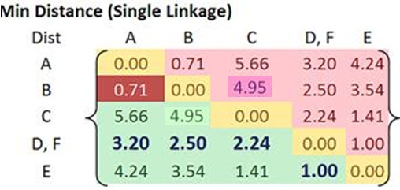
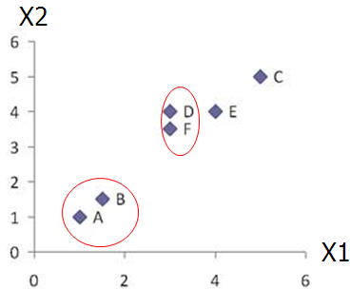
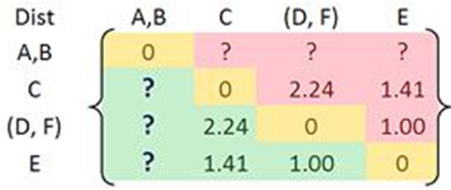
Example
Merge two closest clusters (iteration 2)
Ref: [6]

Slide 22
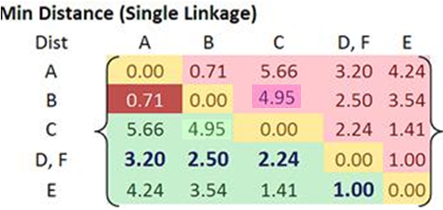

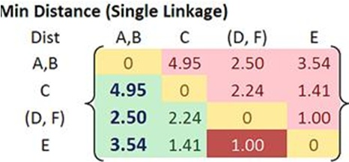
Example
Update distance matrix (iteration 2)
Ref: [6]

Slide 23
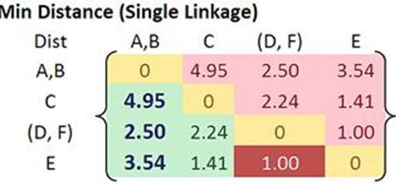
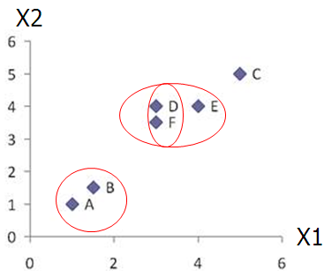
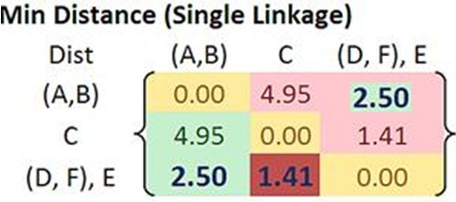

Example
Merge two closest clusters/update distance matrix (iteration 3)
Ref: [6]

Slide 24
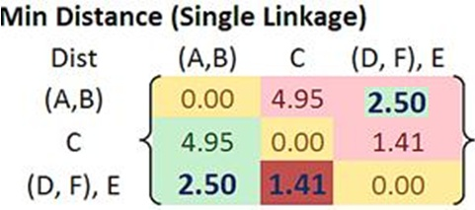
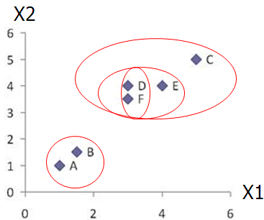
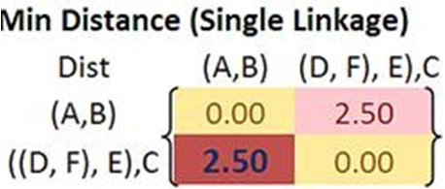

Example
Merge two closest clusters/update distance matrix (iteration 4)
Ref: [6]

Slide 25
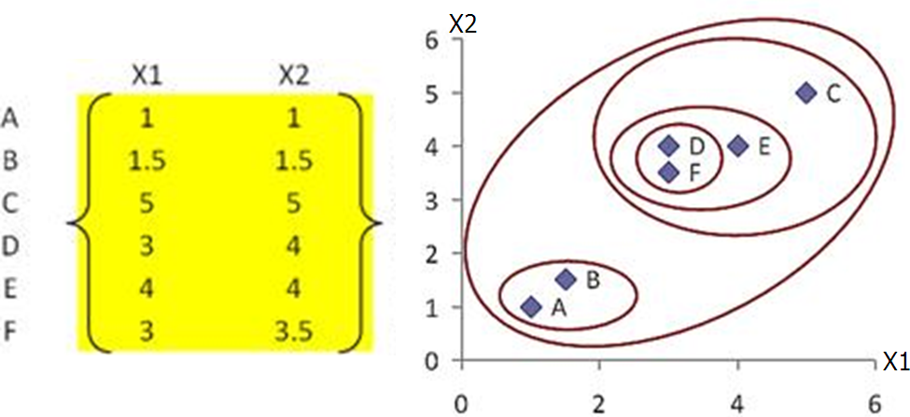
Example
Final result (meeting termination condition)
Ref: [6]

Slide 26
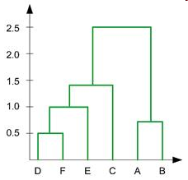
Key Concepts in Hierarchal Clustering
Dendrogram tree representation
In the beginning we have 6
clusters: A, B, C, D, E and F
We merge clusters D and F into
cluster (D, F) at distance 0.50
We merge cluster A and cluster B
into (A, B) at distance 0.71
We merge clusters E and (D, F)
into ((D, F), E) at distance 1.00
We merge clusters ((D, F), E) and C
into (((D, F), E), C) at distance 1.41
We merge clusters (((D, F), E), C)
and (A, B) into ((((D, F), E), C), (A, B))
at distance 2.50
The last cluster contain all the objects,
thus conclude the computation
6
lifetime
5
4
3
2
object
Ref: [6]
Notes:
For a dendrogram tree, its horizontal axis indexes all objects in a given data set, while its vertical axis expresses the lifetime of all possible cluster formation.
The lifetime of a cluster (individual cluster) in the dendrogram is defined as a distance interval from the moment that the cluster is created to the moment that it disappears by merging with other clusters.

Slide 27
Homework Exercise – AGNES (Try at your free time)
Problem:
Cluster the following eight points (with (x, y) representing locations) into three clusters A1(2, 10), A2(2, 5), A3(8, 4), A4(5, 8), A5(7, 5), A6(6, 4), A7(1, 2) and A8(4, 9) using single-link, complete-link, average-link agglomerative clustering
The distance function between two points a=(x1, y1) and b=(x2, y2) is defined as: ρ(a, b) = |x2 – x1| + |y2 – y1| .

Slide 28
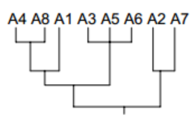
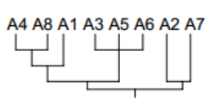
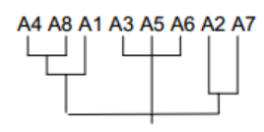
Result
Complete Link
Single Link
Average Link

Slide 29
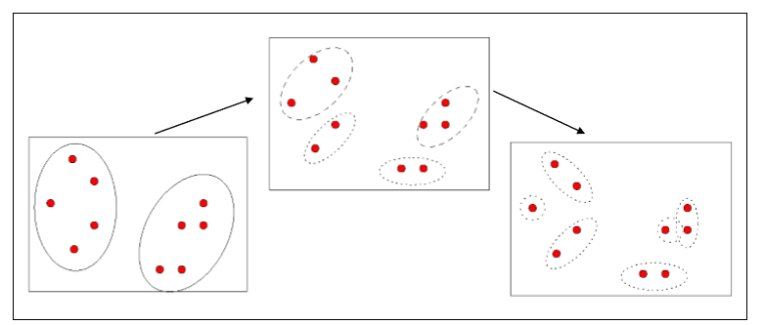
DIANA (Divisive Analysis)
Step1: all the objects are placed in one cluster
Step2: split the clusters according to the maximum Euclidean distance between the nearest objects in the clusters
Step3: if each cluster contains only one object, exit; otherwise go to Step 2

Slide 30
Density-based clustering

Slide 31
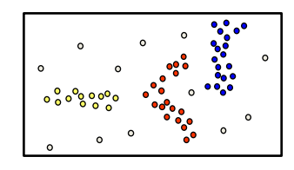
Density-based clustering
Basic idea
Clusters are dense regions in the data space, separated by regions of lower object density
A cluster is defined as a maximal set of density connected points – Discovers clusters of arbitrary shape

Slide 32

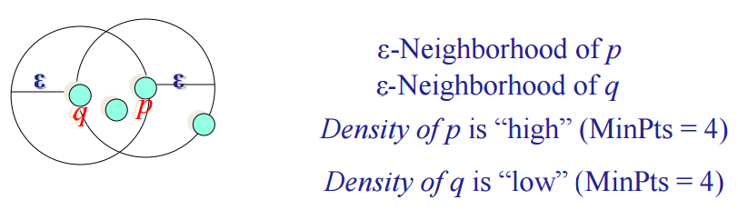
Density Definition
Two parameters:
Eps (ε): Maximum radius of the neighbourhood ()
MinPts: Minimum number of points in an Eps-neighbourhood of that point
ε-Neighborhood – Objects within a radius of ε from an object.
“High density” - ε-Neighborhood of an object contains at least MinPts of objects.

Slide 33
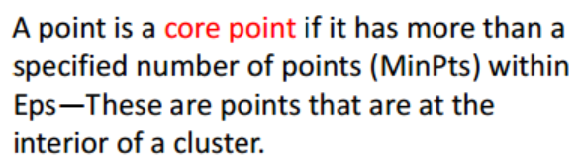
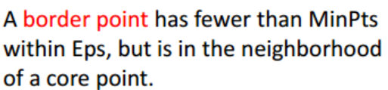

Definitions
Outlier
Border
Eps = 1cm
MinPts = 5
Core

Slide 34
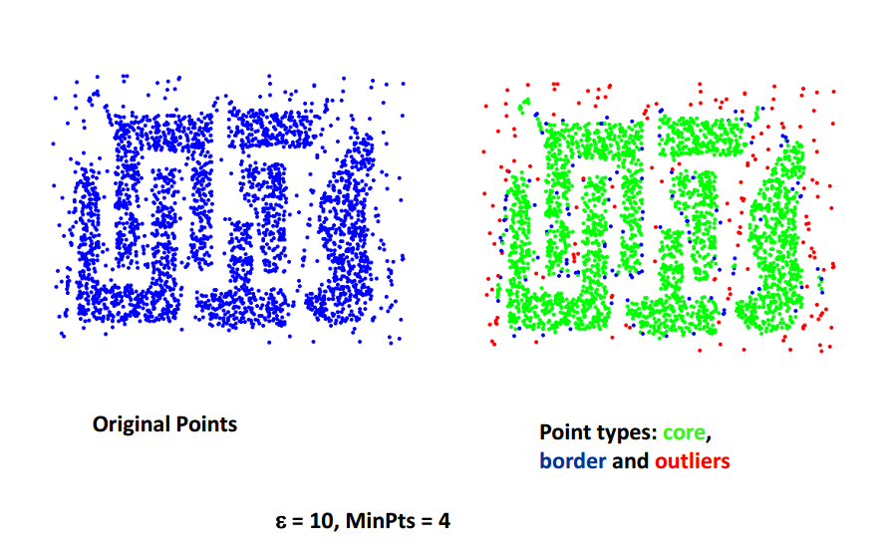
Example

Slide 35
DBSCAN(Density-based spatial clustering of applications with noise)
b
c
d
a
e
Principle 1: Each cluster contains at least one core point.
Principle 2: Given any two core points p and q, if N(p) contains q (or N(q) contains p), then p and q are in the same cluster.
Principle 3: Consider a border point p to be assigned to one of the clusters formed by Principle 1 and Principle 2. Suppose N(p) contains multiple core points. A border point p is assigned arbitrarily to one of the clusters containing these core points (formed by Principle 1 and Principle 2).
Principle 4: All noise points do not belong to any clusters.

Slide 36
DBSCAN: The Algorithm
Arbitrary select a point p
Retrieve all points density-reachable from p w.r.t. Eps and MinPts
If p is a core point, a cluster is formed
If p is a border point, no points are density-reachable from p and DBSCAN visits the next point of the database
Continue the process until all of the points have been processed

Slide 37
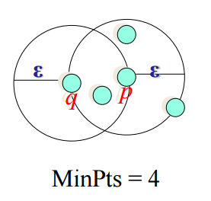
Density-Reachable
An object q is density-reachable from object p if :-
p is a core object and
q is in p’s ε –neighborhood
q is density-reachable from p
p is not density-reachable from q

Slide 38
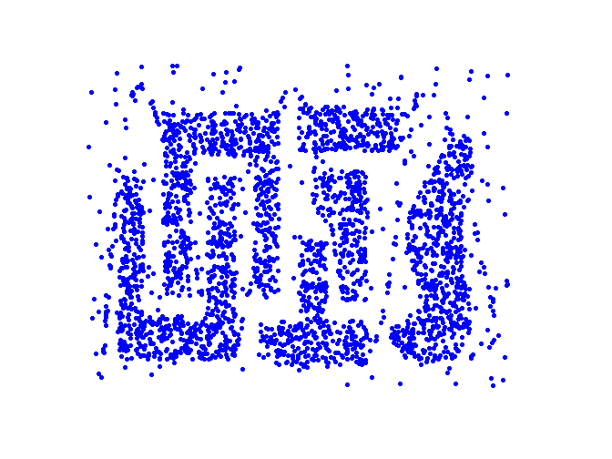
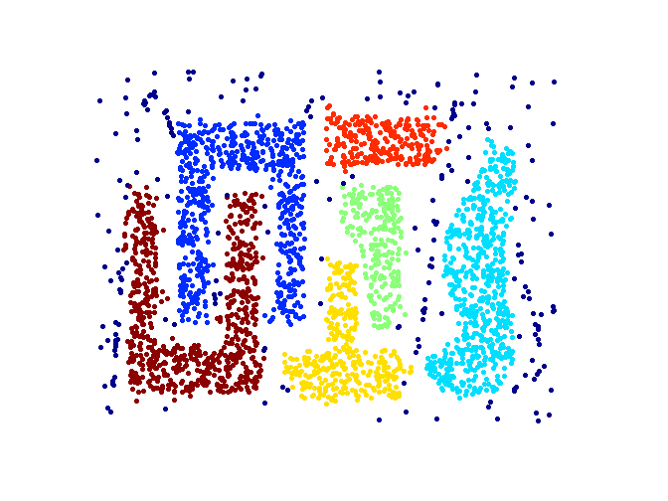
When DBSCAN Works Well
Original Points
Clusters
Resistant to Noise
Can handle clusters of different shapes and sizes

Slide 39
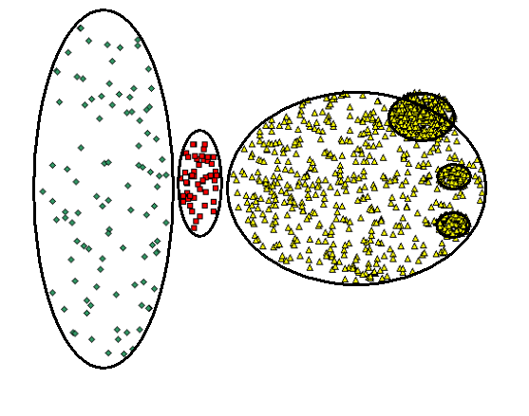
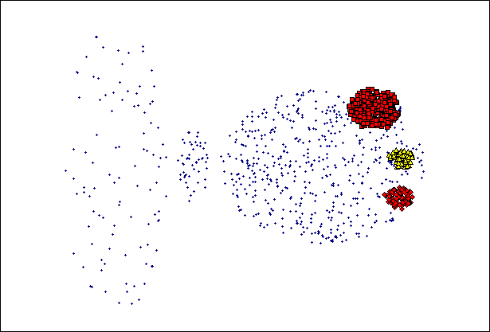
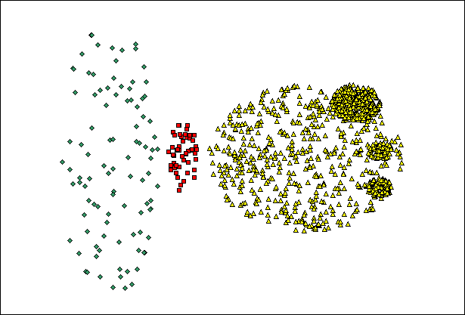
When DBSCAN Does NOT Work Well
(MinPts=4, Eps=9.75).
Original Points
Varying densities
High-dimensional data
(MinPts=4, Eps=9.92)

Slide 40
Exercise
If Epsilon is 2 and minpoint is 2, what are the clusters that DBScan would discover with the following 8 examples: A1=(2,10), A2=(2,5), A3=(8,4), A4=(5,8), A5=(7,5), A6=(6,4), A7=(1,2), A8=(4,9).
The distance function between two points a=(x1, y1) and b=(x2, y2) is defined as: ρ(a, b) = |x2 – x1| + |y2 – y1| .
 | 1 | 2 | 3 | 4 | 5 | 6 | 7 | 8
1 | 0 | 5 | 12 | 5 | 10 | 10 | 9 | 3
2 | 5 | 0 | 7 | 6 | 5 | 5 | 4 | 6
3 | 12 | 7 | 0 | 7 | 2 | 2 | 9 | 9
4 | 5 | 6 | 7 | 0 | 5 | 5 | 10 | 2
5 | 10 | 5 | 2 | 5 | 0 | 2 | 9 | 7
6 | 10 | 5 | 2 | 5 | 2 | 0 | 8 | 7
7 | 9 | 4 | 9 | 10 | 7 | 8 | 0 | 9
8 | 3 | 6 | 9 | 2 | 9 | 7 | 9 | 0

Slide 41
Solution
First get the Epsilon neighborhood of each point.
N2(A1)={};
N2(A2)={};
N2(A3)={A5, A6};
N2(A4)={A8};
N2(A5)={A3, A6};
N2(A6)={A3, A5};
N2(A7)={};
N2(A8)={A4}
 | 1 | 2 | 3 | 4 | 5 | 6 | 7 | 8
1 | 0 | 5 | 12 | 5 | 10 | 10 | 9 | 3
2 | 5 | 0 | 7 | 6 | 5 | 5 | 4 | 6
3 | 12 | 7 | 0 | 7 | 2 | 2 | 9 | 9
4 | 5 | 6 | 7 | 0 | 5 | 5 | 10 | 2
5 | 10 | 5 | 2 | 5 | 0 | 2 | 9 | 7
6 | 10 | 5 | 2 | 5 | 2 | 0 | 8 | 7
7 | 9 | 4 | 9 | 10 | 7 | 8 | 0 | 9
8 | 3 | 6 | 9 | 2 | 9 | 7 | 9 | 0

Slide 42
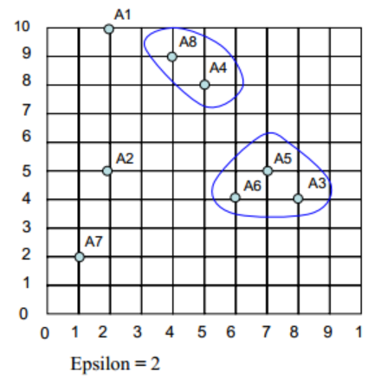
Solution
So A1, A2, and A7 are outliers
And we have two clusters C1={A4, A8} and C2={A3, A5, A6}

Slide 43
Summary DBSCAN
Good:-
Can detect arbitrary shapes
Not very sensitive to noise
Supports outlier detection
Medium complexity
Beside K-means the second most used clustering algorithm.
Bad:-
Does not work well in high-dimensional datasets
Parameter selection is tricky,
Has problems of identifying clusters of varying densities

Slide 44
References
[1] Han, J., Pei, J., & Kamber, M. (2011). Data mining: concepts and techniques.
[2] Peter Bruce , and Andrew Bruce (2017) Practical Statistics for Data Scientists
[3] R for Data Science. Book by Garrett Grolemund and Hadley Wickham
[4] https://www.youtube.com/watch?v=EmxxOyLcYrw
[5] www.cs.cmu.edu › ~knigam › clustering-lecture
6] syllabus.cs.manchester.ac.uk › ugt › COMP24111 › materials › slides

